Slide 1
INFOGRAPHICS
Aoife O’Driscoll
www.aoifesnotes.com

Slide 2
Infographic
The word comes from ‘Informational Graphic’

Slide 3
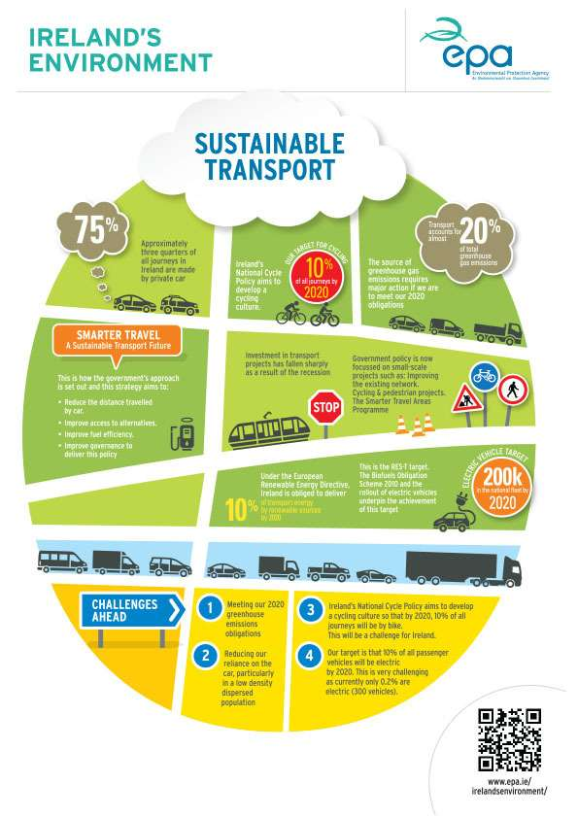
What is an infographic and why is it such a popular way of providing information?
Charts, images, diagrams and a little text
Images are usually clear, colorful and striking
The purpose of an infographic is to convey complicated information clearly and quickly
Infographics provide a quick overview
They are easily-understood

Slide 4
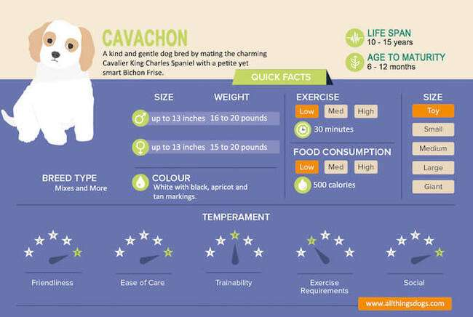

Slide 5
Who uses infographics?
Researchers presenting findings
Educators presenting complex material
Journalists analysing a topic
Charities and organisations raising awards about issues
People in marketing who want to improve brand awareness
Project managers explaining timelines to clients
Etc.

Slide 6
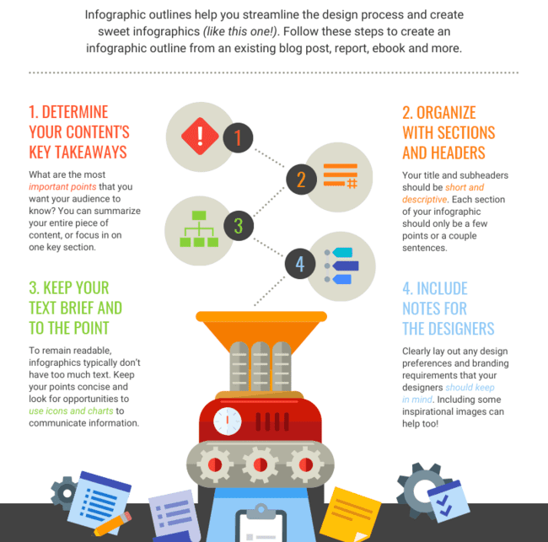

Slide 7
Tips for creating a good infographic
Graphics should be clear and simple
Avoid using too many colours
Keep text to a minimum
Make sure the language is straightforward and readable
Make sure your infographic flows naturally and makes sense to the reader
Don’t repeat yourself

