Slide 1
Writing An Open Letter
www.aoifesnotes.com

Slide 2

Why write an open letter?
To reach a wide audience
To defend oneself, express a strong view or make an appeal
Open letters are often aimed at an individual or group but are intended to be shared with the public

Slide 3

Sample Open Letter
The next slide contains the text of an open letter written by Siegfried Sassoon in July 1917
It was distributed widely, read in the House of Commons and printed in the London Times

Slide 4
Lt. Siegfried Sassoon
3rd Batt: Royal Welsh Fusiliers
I am making this statement as an act of wilful defiance of military authority because I believe that the war is being deliberately prolonged by those with the power to end it. I am a soldier, convinced that I am acting on behalf of soldiers. I believe that the war upon which I entered as a war of defence and liberation has now become a war of agression and conquest. I believe that the purposes for which I and my fellow soldiers entered upon this war should have been so clearly stated as to have made it impossible to change them and that had this been done the objects which actuated us would now be attainable by negotiation.
I have seen and endured the sufferings of the troops and I can no longer be a party to prolong these sufferings for ends which I believe to be evil and unjust. I am not protesting against the conduct of the war, but against the political errors and insincerities for which the fighting men are being sacrificed.
On behalf of those who are suffering now, I make this protest against the deception which is being practised upon them; also I believe it may help to destroy the callous complacency with which the majority of those at home regard the continuance of agonies which they do not share and which they have not enough imagination to realise.

Slide 5
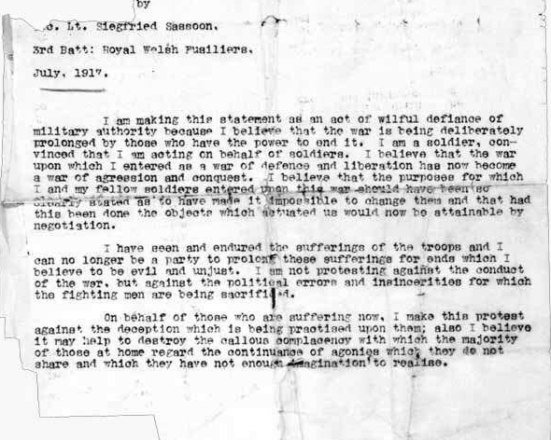

Slide 6
Format of an Open Letter
The name of the author and the date usually appear at the top of the letter, as in Sassoon’s example. However, there is no hard and fast rule and if you prefer to sign off at the end, you may do so.
There is no need for the sender/recipient’s address
If you wish to address your open letter to an individual or a group, do so. You can do this by giving your open letter a title: ‘An open letter to all those who offer unwanted advice’
Provide a brief introduction outlining the reason or reasons you felt you had to write the letter
Your points should be logically organised
Be coherent and precise throughout
Your conclusion should be related to the point you made at the outset and should, ideally, include some sort of call to action

Slide 7

Four Questions You Should Ask Yourself
What is the task? - In this case, it is quite clear: an open letter
What should the content be? - This will be determined by the question
Who is my audience? - The public
What sort of language should I use? - Formal, language of argument and/or persuasion

Slide 8

Pitfalls
Attacking the reader or the subject of the letter in an inappropriately aggressive manner: you can of course criticize, but your tone should be reasonable and rational
Providing unnecessary information or going off topic
Structuring your letter poorly
Failing to make it clear what you hope to achieve by writing this letter

